Slide 1
RESOLUTION IN PROPOSITIONAL LOGIC –LINEAR RESOLUTION
Hoszu Bernadett – IE group 913
24.12.2021

Slide 2
What is resolution?
Resolution is a proof method in propositional and predicate logic
Its basic aim is to check (in)consistency of a set of clauses
It is a syntactic proof method
Its formal system is composed of:
Alphabet: ¬, ˅
The set of all clauses built using the alphabet:
contains ◻ - the empty clause (symbolizes inconsistency)
The set of axioms: ∅
The set of inference rules:
contains the resolution rule: f ˅ l, g ˅ ¬l ⊢_{res} f ˅ g

Slide 3
What is linear resolution?
C₀
B₀
Linear resolution is a refinement of the resolution proof method. A refinement makes the solution more efficient by imposing restrictions on the clashing clauses.
One can linearly deduce C_{n} from the set of clauses S with C₀∊ S as top clause as follows in the figure
C₀ – top clause
C₁ ,.....,C_{n} – central clauses
B₀ ,....., B_{n-1} – side clauses
∀i=1,..,n C_{i} = Res(C_{i-1,} B_{i-1})
∀i=1,..,n-1 B_{i} ∊ S∪(C₀,..., C_{i-2})
C₁
B₁
C₂
B₂
C_{n-1}
B_{n-1}
C_{n}

Slide 4
Some notions in resolution…
clashing clauses : eg. C₁ = f ˅ l & C₂ = g ˅ ¬l
they resolve upon the literal l : C = Res_{l} (C₁, C₂) = f ˅ g
C – resolvent; C₁, C₂ – parent clauses
! If C₁ = l and C₂ = ¬l ,then Res_{l} (C₁, C₂) = ◻ (inconsistency)

Slide 5

Soundness & Completeness
Theorem: The set of clauses S is inconsistent if and only if S${\text{⊢}}_{Res}^{lin}$ ◻

Slide 6
Strategy
We can combine the linear resolution with the deletion strategy and the completeness property is preserved.
Strategies assure that all the possible clauses to be derived are generated.
Deletion strategy: the resolvents that are tautologies or are subsumed by other clauses in the set S of clauses are eliminated and they will not be used further in the resolution process because they produce redundant clauses.

Slide 7
Backtracking algorithm
In each iteration, for the current central clause there are more possible side clauses. We continue the resolution process choosing one side clause.
In the iteration i the process is blocked when:
The central clause C_{i} is a tautology
The central clause C_{i} is an existing central clause (C_{i} = C_{j} , j<i)
We go back to the previous iteration, i-1, if in the iteration i the process is blocked or all the side clauses of C_{i} were used. Then we choose another possible side clause for C_{i-1} and continue the resolution process.

Slide 8
Backtracking algorithm
The algorithm stops in two cases:
The empty clause was derived and the conclusion is that S is inconsistent.
For the top clause all the possible side clauses were used, but the empty clause was not derived. We conclude that the set S is consistent.
The consistency of a set is proved after a complete search without derivation of the empty clause.

Slide 9
Exercise 5.3
Exercises_Resolution_proposition_2020-2021.docx

Slide 10

Problem statement
Prove the consistence of the following set of clauses using linear resolution:
$$S=\left\{ p˅q, r˅p˅¬q, ¬r˅¬p \right\}$$

Slide 11

Solution
Let us denote:
C₁ = $p˅q$
C₂ =$r˅p˅¬q$
C₃ =$¬r˅¬p$
Hence, S = {C_{1,} C_{2,} C₃}
Let us choose C₁ as top clause.
In order to prove the consistency of the set S we apply the backtracking algorithm.

Slide 12







$S=\left\{ p˅q, r˅p˅¬q, ¬r˅¬p \right\}$ C1 = $p˅q,$ C2 =$r˅p˅¬q,$ C3 =$¬r˅¬p$ r *resolution rule: f ˅ l, g ˅ ¬l ⊢res f ˅ g
Option 1
C1 = $p˅q$
C₂ =𝑟˅𝑝˅¬𝑞
C₃
First iteration:
C₁ is the top clause and it has two possible side clauses: C₂ and C₃
Option 1: C₂ is used as a side clause for C₁
Second iteration:
C₄ = Res_{q} (C₁, C₂) = r ˅ p
! Note that C₄ and C₃ can be resolved in two ways: with p and then with r as the literal resolved upon.
Option 1.1: C₃ is used as a side clause for C₄
Third iteration:
C₅ = Res_{p} (C₄, C₃) = r ˅¬r ≡ T - tautology (*)
process is blocked
We go back to the previous iteration.
Option 1.2: C₃ is used as a side clause for C₄
Fourth iteration:
C₆ = Res_{r} (C₄, C₃) = p ˅¬p ≡ T - tautology (*)
process is blocked
We go back to the previous iteration.
All possible side clauses of C₄ were used.
We go back to the previous iteration.
Option 1.1
C₄ = $r˅p$
C₃ =$¬r˅¬p$
C₃
C₅ =$r˅¬r ≡T$
tautology
Option 1.2
C₄ = $r˅p$
C₃
C₃ =$¬r˅¬p$
C₆ =$p˅¬p ≡T$
tautology

Slide 13





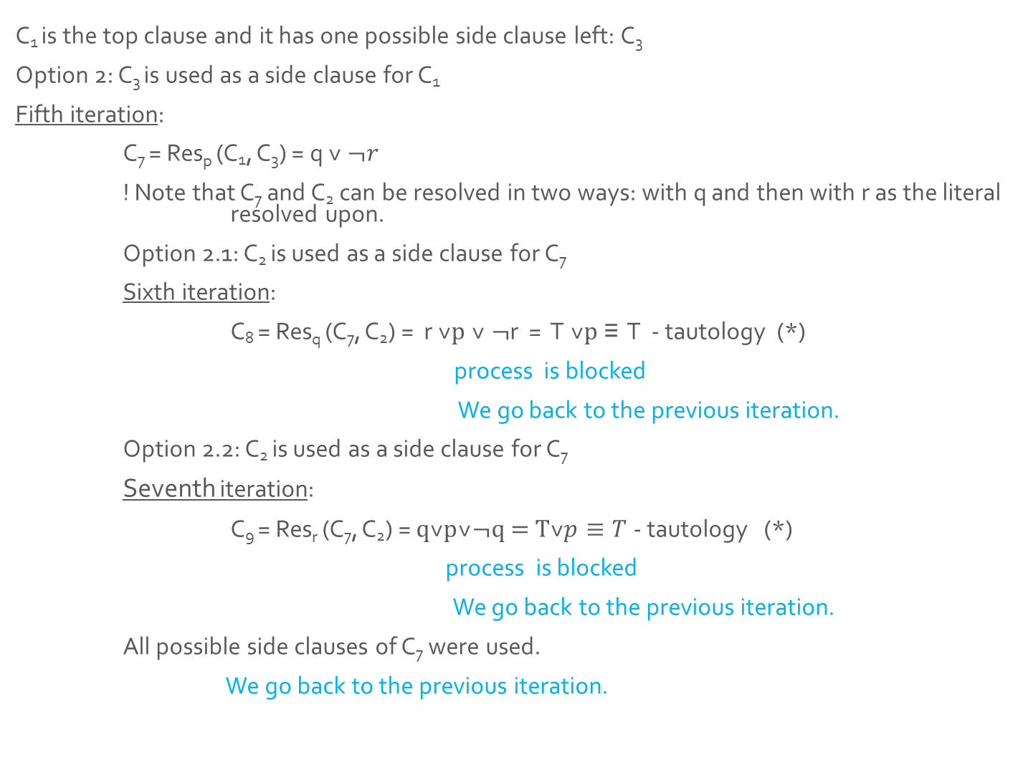



$S=\left\{ p˅q, r˅p˅¬q, ¬r˅¬p \right\}$ C1 = $p˅q,$ C2 =$r˅p˅¬q,$ C3 =$¬r˅¬p$ r *resolution rule: f ˅ l, g ˅ ¬l ⊢res f ˅ g
Option 2
C₁ is the top clause and it has one possible side clause left: C₃
Option 2: C₃ is used as a side clause for C₁
Fifth iteration:
C₇ = Res_{p} (C₁, C₃) = q ˅ $¬r$
! Note that C₇ and C₂ can be resolved in two ways: with q and then with r as the literal resolved upon.
Option 2.1: C₂ is used as a side clause for C₇
Sixth iteration:
C₈ = Res_{q} (C₇, C₂) = r ˅p ˅ ¬r = T ˅p ≡ T - tautology (*)
process is blocked
We go back to the previous iteration.
Option 2.2: C₂ is used as a side clause for C₇
Seventh iteration:
C₉ = Res_{r} (C₇, C₂) = $q˅p˅¬q\text{ = }\text{T}˅p≡T$- tautology (*)
process is blocked
We go back to the previous iteration.
All possible side clauses of C₇ were used.
We go back to the previous iteration.
C1 = $p˅q$
C₂
C₃ =$¬r˅¬p$
Option 2.1
C₇ = $q˅¬r$
C₂ =$r˅p˅¬q$
C₂
C₈ =$r˅p˅¬r =T˅p≡T$p
tautology
Option 2.2
C₇ =$q˅¬r$
C₂
C₂ =$r˅p˅¬q$
C₉ =$q˅p˅¬q \text{= }\text{T}˅p≡T$
tautology

Slide 14
Ending the algorithm…
…. All possible side clauses of C₁ were used.
Since there is no previous iteration left to go back to, we end the algorithm here.
end_backtracking

Slide 15
Conclusion
A complete linear derivation search was performed, but the empty clause was not derived, so S is a consistent set of clauses.

Slide 16
A final blink at the whole scheme of the solution…
Option 1
Option 2
C1
C₂
C₃
C1
C₂
C₃
Option 1.1
Option 1.2
Option 2.1
Option 2.2
C₄
C₃
C₃
C₄
C₃
C₃
C₇
C₂
C₂
C₇
C₂
C₂
C₅
C₆
C₈
C₉
tautology
tautology
tautology
tautology

